Slide 1
Anomaly detection in graphs - past, present and future.
Leman Akoglu CMU
Mary McGlohon Google
Christos Faloutsos CMU

Slide 2
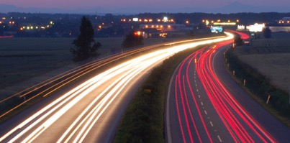
Roadmap
Introduction – Motivation
Past
Present
Future

Slide 3
Roadmap
Introduction – Motivation
Past
Present
Future
Q1) definition?
Q2) automation?
Q3) next steps?

Slide 4
Future – parting thoughts
Q1) Definition of anomaly?
A) “… strange/remote/unlikely, wrt our biases/priors”
Q2) can we automate it?
A) no, but: look for better models/biases/priors
Q3) next steps?
A) cross-disciplinarity -> new+better models

Slide 5
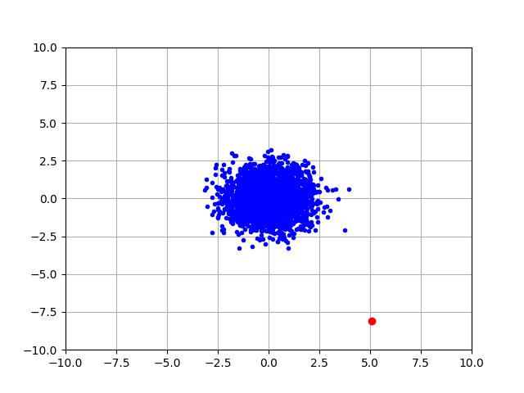
Q1) definition
‘deviation from the common rule’
https://www.merriam-webster.com/dictionary/anomaly

Slide 6
Q1) definition
‘deviation from the common rule’
https://www.merriam-webster.com/dictionary/anomaly
But: Who spots the rules?

Slide 7
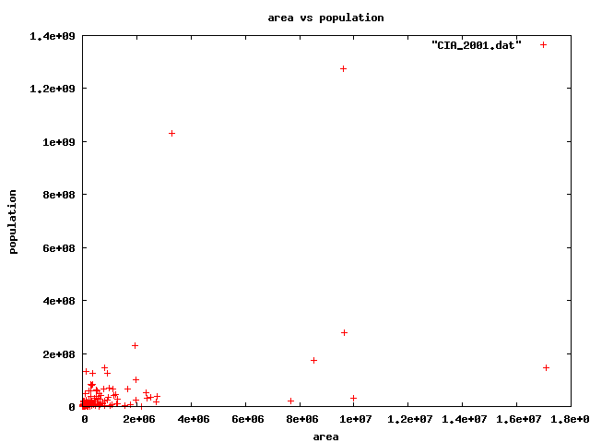
Q1: rules?

Slide 8
Q1: rules?

Slide 9
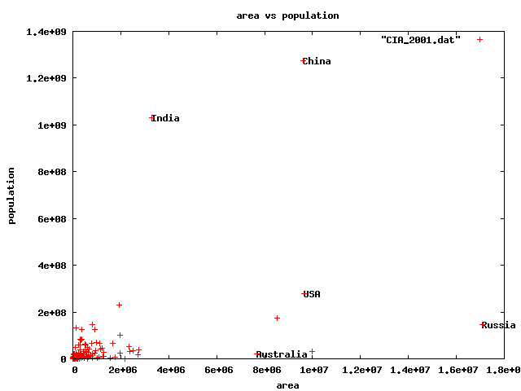
Q1) rules?
🇨🇳
🇮🇳
🇱🇷
🇷🇺

Slide 10
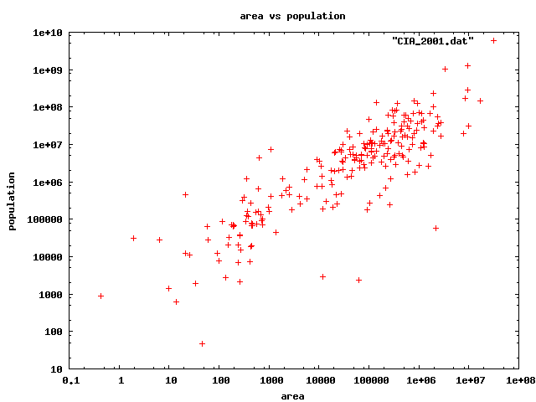
For fun: identification
Highest density
lowest density
47 residents(!)

Slide 11
Q1) rules?

Slide 12
Q1) rules?

Slide 13
Q1) rules?

Slide 14
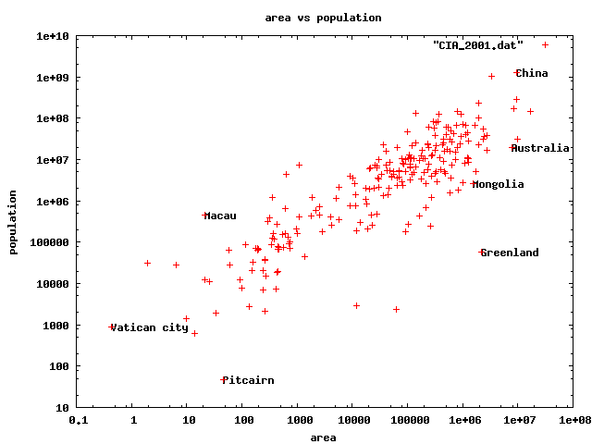
Q1) rules
47 residents(!)

Slide 15
Q1) rules?
47 residents(!)

Slide 16
Q1) definition
‘deviation from the common rule’
https://www.merriam-webster.com/dictionary/anomaly
Once we agree on the rules / axis-scales, outliers are better defined.
But: Who spots the rules?

Slide 17
Roadmap
Introduction – Motivation
Past
Present
Future
Q1) definition?
Q2) automation?
Q3) next steps?

Slide 18
Future – parting thoughts
Q1) Definition of anomaly?
A) “… strange/remote/unlikely, wrt our biases/priors”
Q2) can we automate it?
A) no, but: look for better models/biases/priors
Q3) next steps?
A) cross-disciplinarity -> new+better models

Slide 19
Q2) automation?
Q2.1
patterns
Q2.2
anomalies
compression
distance
density

Slide 20
Q2) automation?
Q2.1
patterns
Q2.2
anomalies
compression
distance
density

Slide 21
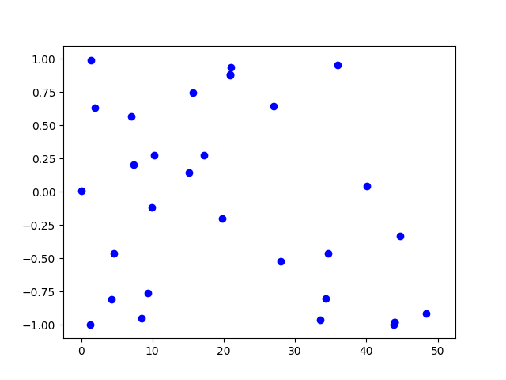
Q2.1) patterns <-> anomalies
Random?

Slide 22
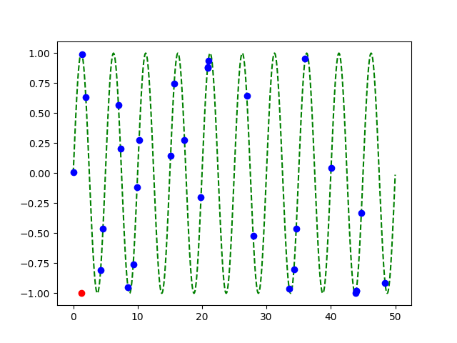
Q2.1) patterns <-> anomalies
Random?
Pattern!
+
Anomaly!

Slide 23
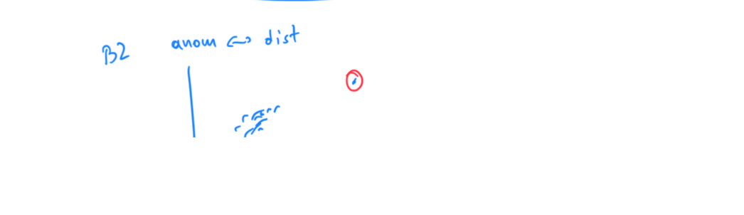

Slide 24
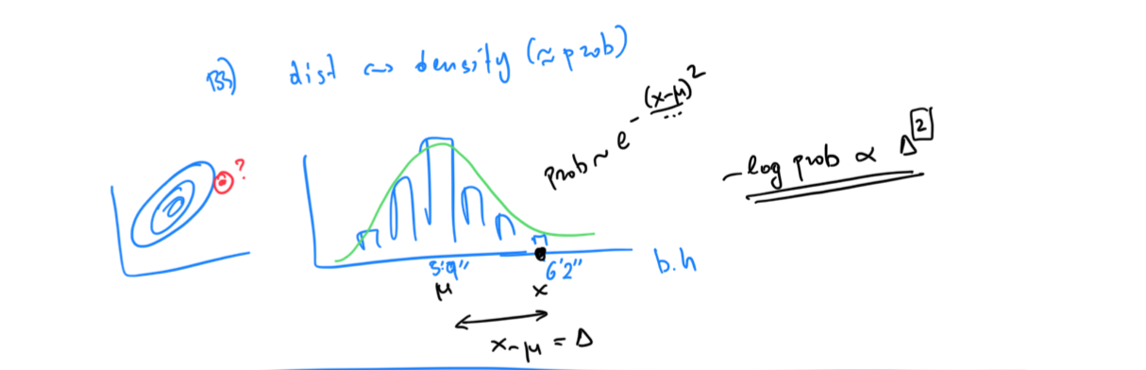

Slide 25
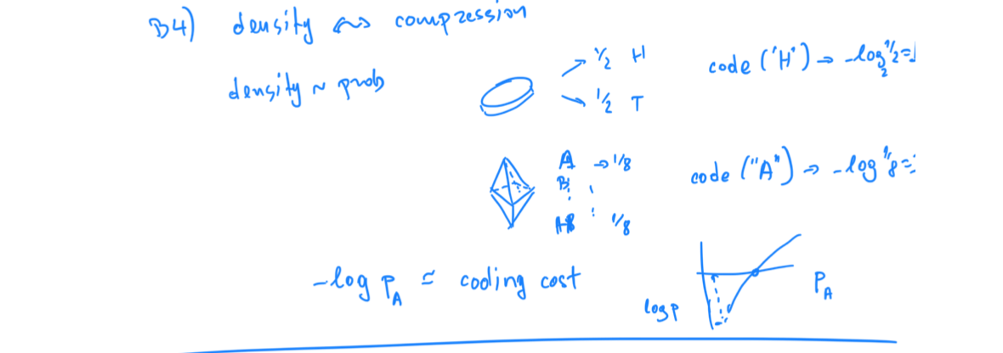

Slide 26
Q2) automation?
✓
Q2.1
patterns
Q2.2
anomalies
compression
distance
density

Slide 27
Q2.2) patterns <-> compression
2 int per point
1 int per point
(plus 3 parm’s of sinusoid,
plus 2 int for outlier)

Slide 28
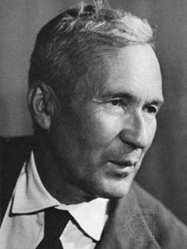
… compression is undecidable!
Theorem*: for an arbitrary string x, computing its Kolmogorov complexity K(x) is undecidable
EVEN WORSE
than NP-hard!
A.N. Kolmogorov
(*) E.g., [T. M. Cover and J. A. Thomas. Elements of Information Theory. John Wiley and Sons,1991, section 7.7]

Slide 29
… compression is undecidable!
…which means there will always be better data mining tools/models/patterns to be discovered
-> job security ☺
-> job satisfaction ☺

Slide 30
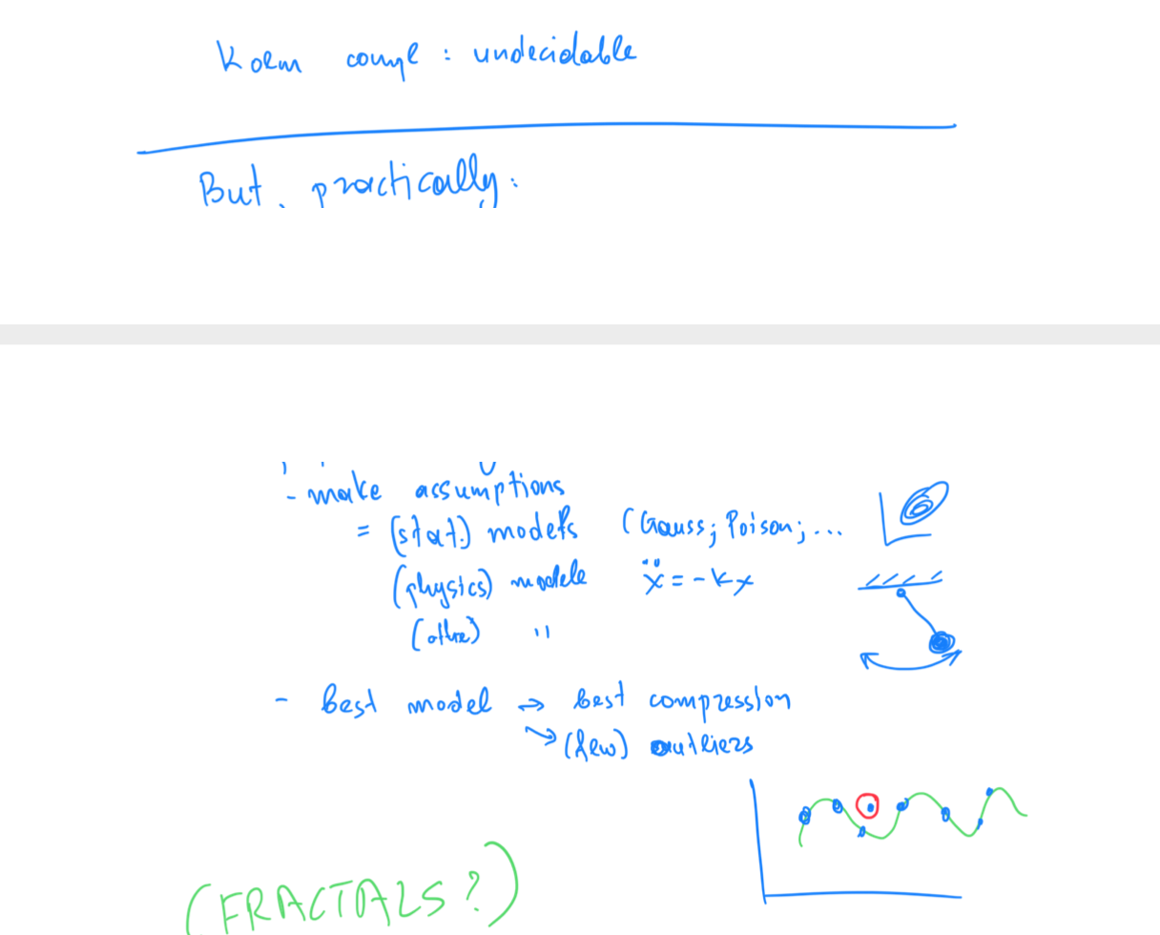

Slide 31
Roadmap
Introduction – Motivation
Past
Present
Future
Q1) definition?
Q2) automation?
Q3) next steps?

Slide 32
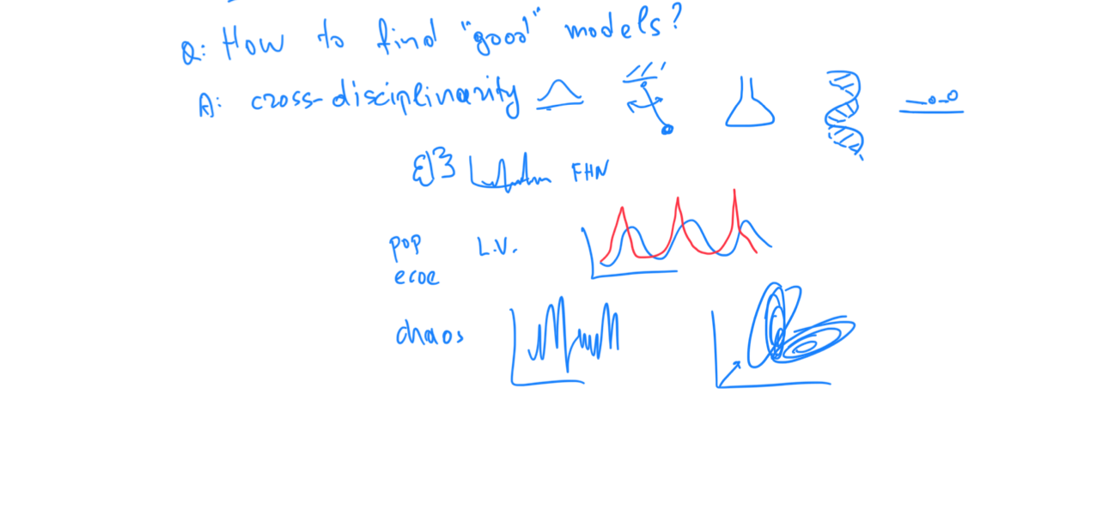

Slide 33
Examples of models
Fractals / self-similarity (Norway)
Logistic parabola (flies; covid)
Lotka-Volterra
Lorenz attractor (laser / synthetic )
Van der Pol / FitzHugh-Nagumo

Slide 34
Q3.1) models

Slide 35
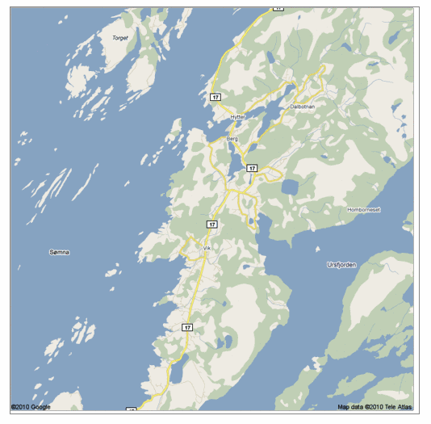
Q: Any pattern?

Slide 36
A: self similar!

Slide 37
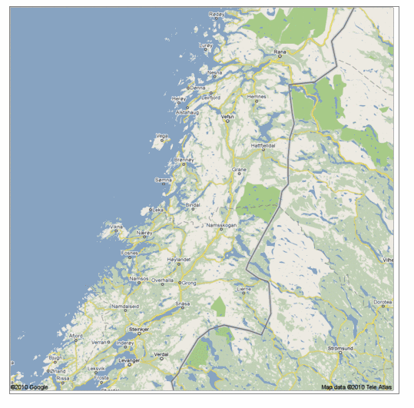
Real, self similar dataset

Slide 38
Real, self similar dataset

Slide 39
Real, self similar dataset

Slide 40
Real, self similar dataset

Slide 41
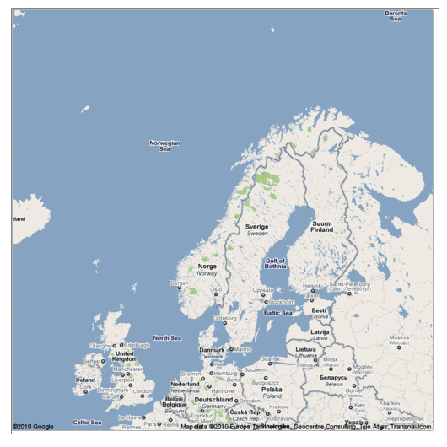
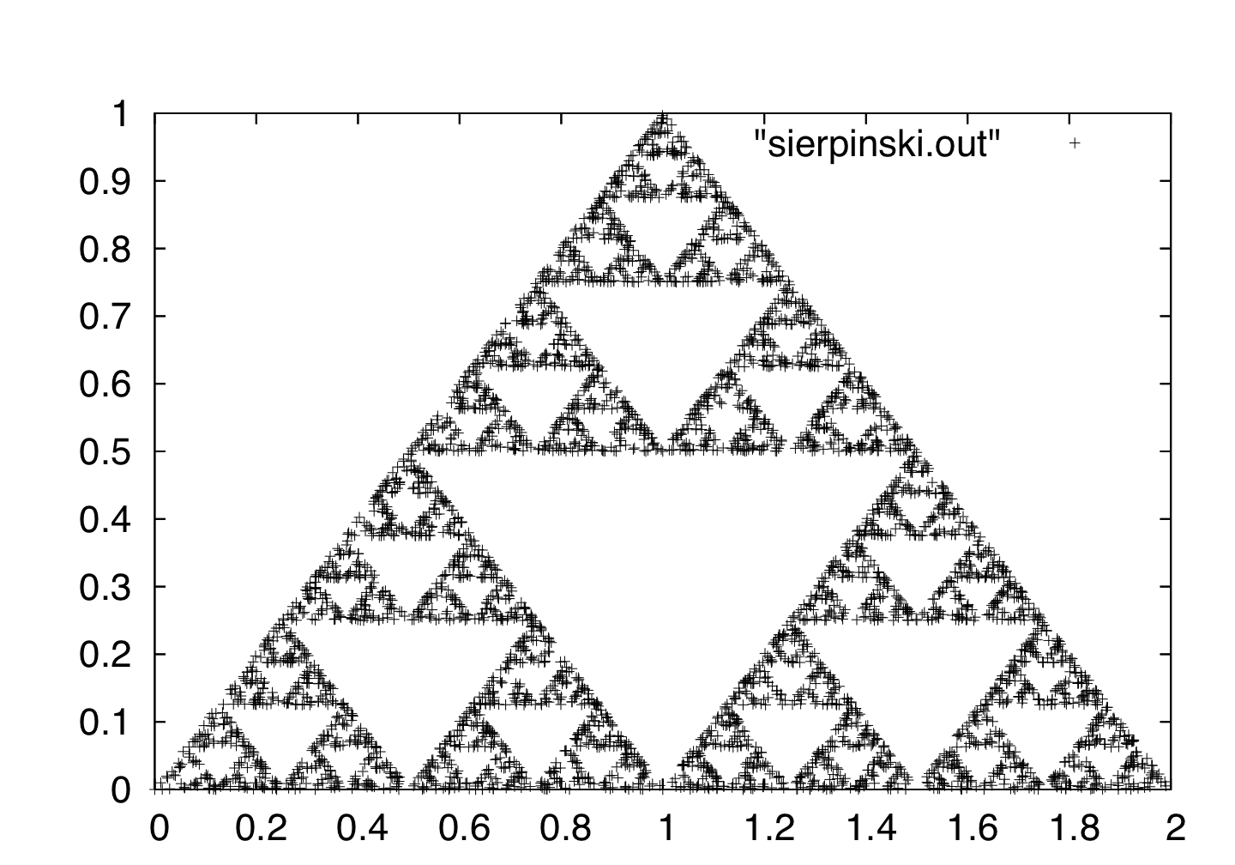
the red is true
origin: Norway
but most other coastlines are ‘self-similar’, too!

Slide 42
How can we find better models?
Obviously, an art (‘undecidable’!)
Helps if we
Listen to domain experts and
Listen to the data (next)

Slide 44
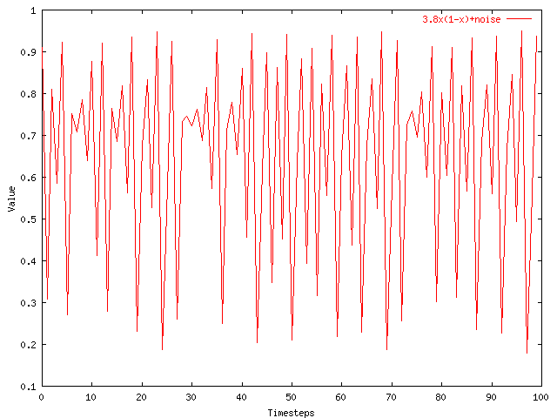
Recall: Problem #1
Value
Time
Given a time series {x_{t}}, predict its future course, that is, x_{t+1}, x_{t+2}, ...

Slide 45
How to forecast?
ARIMA - but: linearity assumption
ANSWER: ‘Delayed Coordinate Embedding’ = Lag Plots [Sauer94]

Slide 46

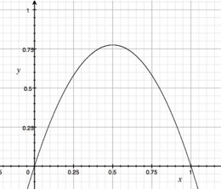
ARIMA pitfall
Example: logistic parabola
Models population of flies [R. May/1976]
Logistic map
Time-series plot
Time t
Notes:
x_{t+1} = a x_t \cdot \left( 1-x_t \right )

Slide 47
ARIMA pitfall
Example: logistic parabola
Models population of flies [R. May/1976]
Logistic map
= SI virus prop. model
~ Bass equation (market penetration)
Special case of Lotka-Volterra
Notes:
x_{t+1} = a x_t \cdot \left( 1-x_t \right )

Slide 49
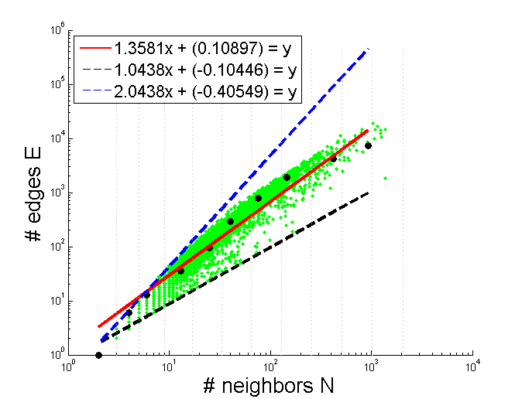
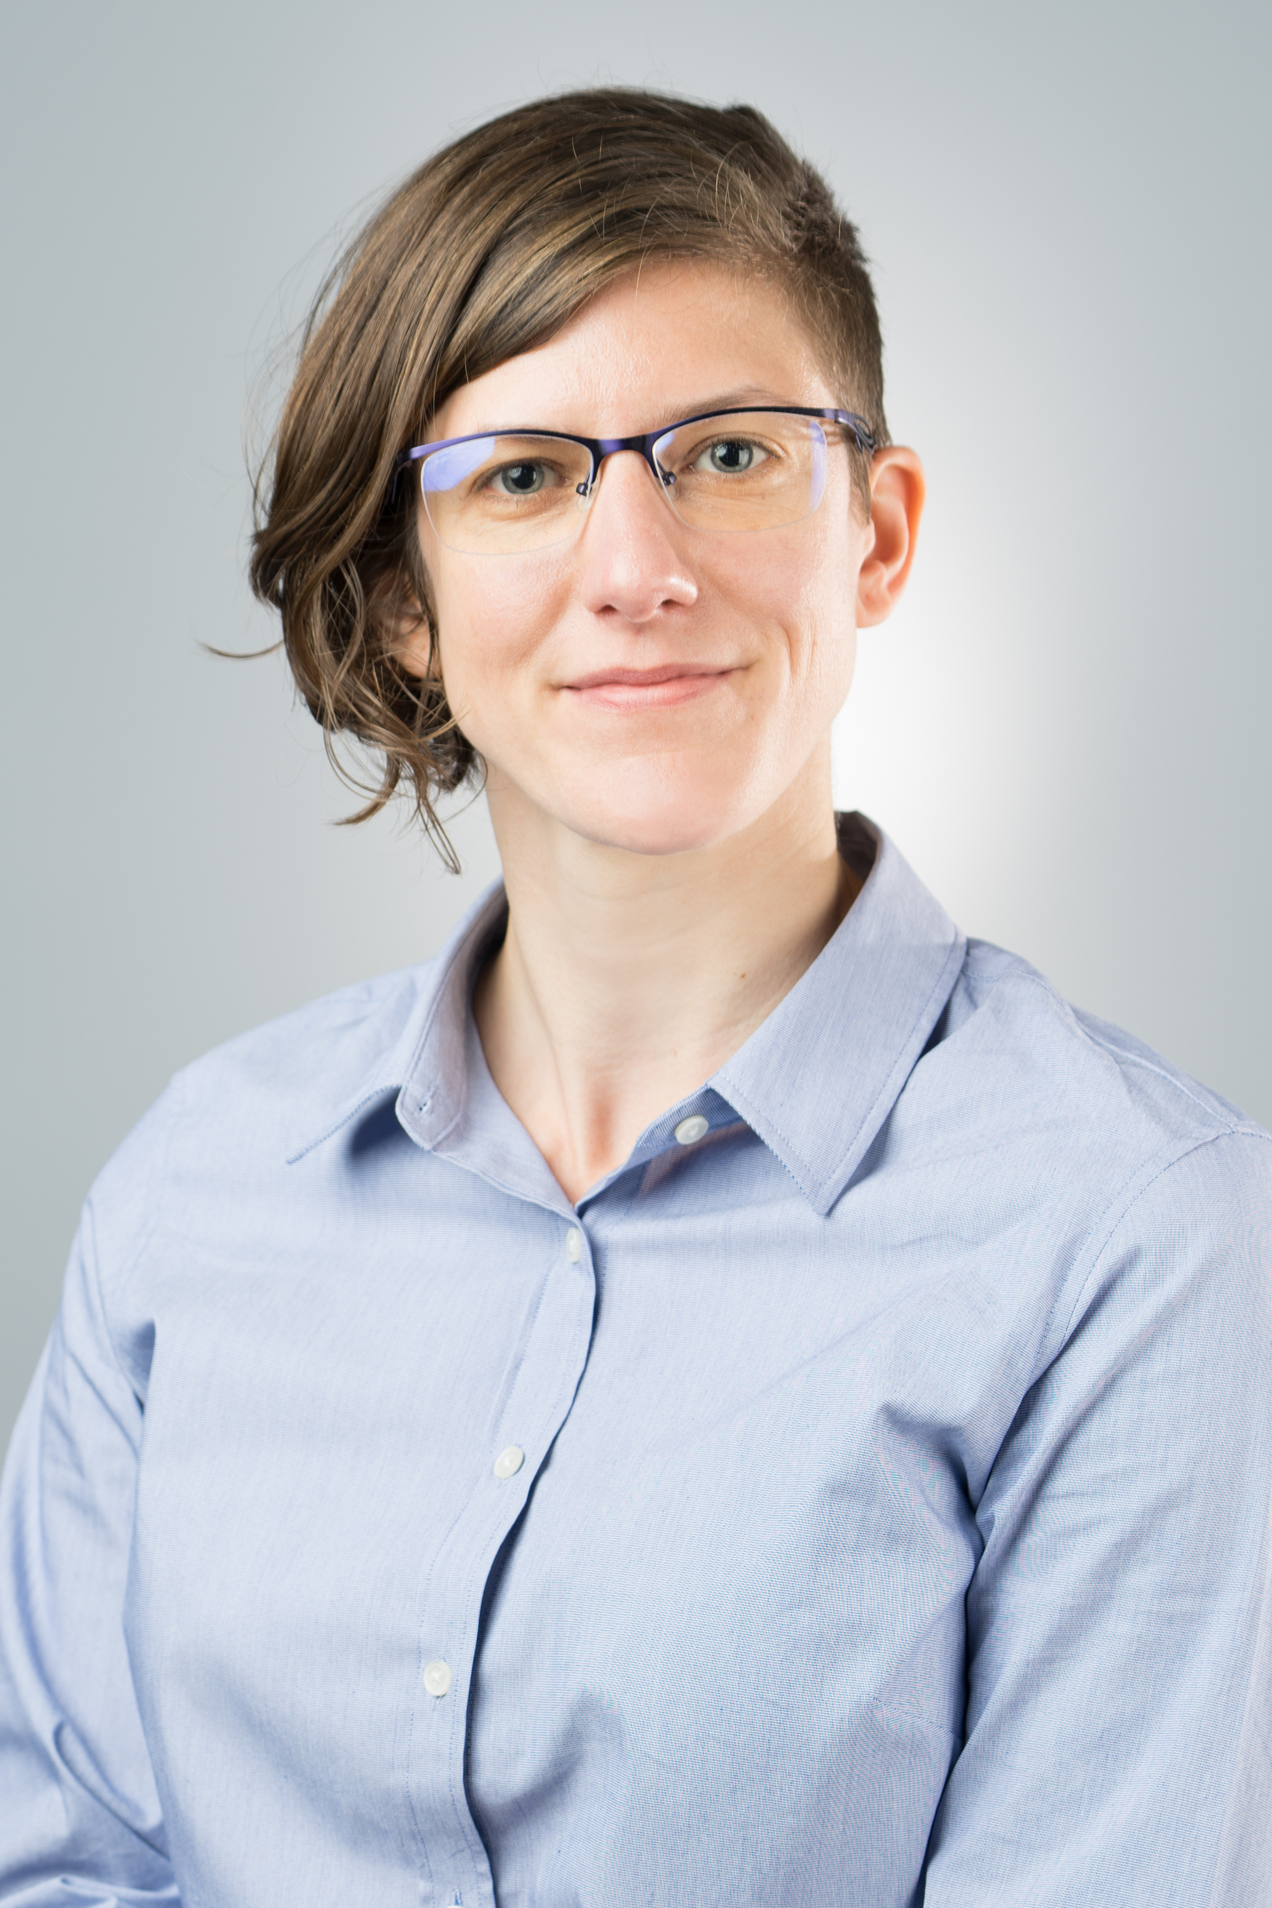
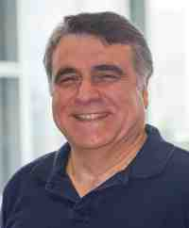
Thank you!

Slide 51
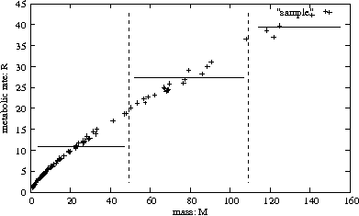
Let’s see some examples of models
Response
to new drug
Body weight

Slide 52
Let’s see some examples of models
$ spent
income

Slide 53
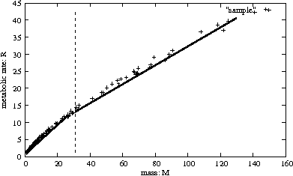
Let’s see some examples of models
$ spent
income

Slide 54
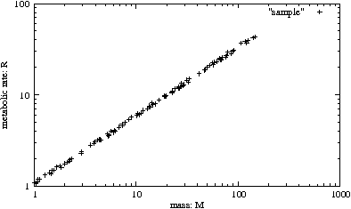
Let’s see some examples of models
$ spent
income

Slide 55
Let’s see some examples of models
$ spent
3/4
income

Slide 56
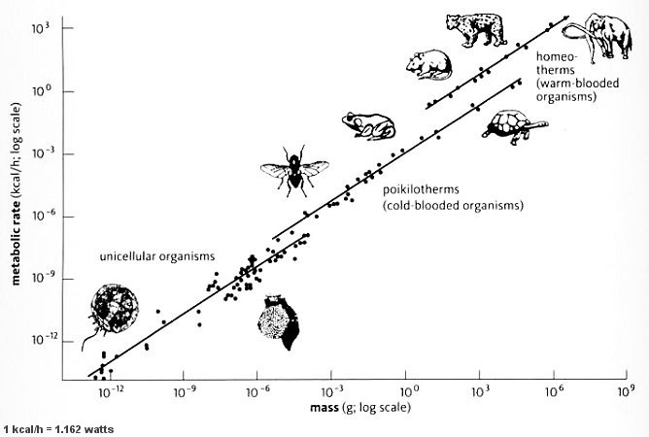
Let’s see some examples of models
Metabolic
rate
3/4
mass
http://universe-review.ca /R10-35-metabolic.htm

Slide 57
Kleiberg’s law
Metabolic
rate
3/4
mass
http://universe-review.ca /R10-35-metabolic.htm

